Slide 1
XML ( Extensible Markup Language )

Slide 2
Introduction to XML
XML (Extensible Markup Language) is a standard for creating markup languages which describe the structure of data.
XML is a mark up language like HTML where tags are not predefined, define your own tags
It is like SGML (Standard Generalized Markup Language) in that it is a meta-language, or a language for describing languages.
XML Defines content structure - how content is stored and categorized.

Slide 3
Introduction to XML
XML can be transformed into a number of desired formats like HTML.
Transformation can be done using XSLT or software programs. XSLT stands for extensible Stylesheet Language Transformation.
It is a language that allows Developers to take an XML source file and transform it into another text-based output format.
The ability to specify new tags, and to create nested tag structures make XML a great way to exchange data, not just documents.

Slide 4
Introduction to XML
DTD: Document Type Definition, a set of rules defining relationships within a document; DTDs can be "internal” or "external”.
XML Parser: Software that reads XML documents and interprets or "parse" the code according to the XML standard. A parser is needed to perform actions on XML, such as comparing an XML document to a DTD.
XML documents, at a minimum, are made of two parts: the prolog and the content. The prolog or head of the document usually contains the administrative metadata about the rest of document.

Slide 5
Introduction to XML
It will have information such as what version of XML is used, the character set standard used, and the DTD, either through a link to an external file or internally.
Content is usually divided into two parts, that of the structural markup and content contained in the markup, which is usually plain text.
<?xml version="1.0" encoding="iso-8859-1"?>
<?xml declares to a processor that this is where the XML document begins.
encoding="iso-8859-1" identifies the standardized character set that is being used to write the markup and content of the XML.

Slide 6
Working With XML
The structural markup consists of elements, attributes, and entities
Elements have a few particular rules:
1. Element names can be any mixture of characters, with a few exceptions. However, element names are case sensitive
The characters that are excluded from element names in XML are &, <, ", and >, which are used by XML to indicate markup.
The character : should be avoided as it has been used for special extensions in XML.
&amp; & &lt; <
&gt; > &quot; “

Slide 7
Working With XML
2. XML documents must have a root element
<root> <child> <subchild>.....</subchild> </child> </root>
3. XML elements must be properly nested
<b><i> bold and italic </i></b>
4. White space is preserved
HTML: Hello User
Output: Hello User
5. XML attribute values must be quoted
<note name = “ abc ”>
6. Comments in XML <!-- comment -->

Slide 8
Working With XML
7. Elements containing content must have closing and opening tags.
<elementName>This is a sample of <anotherElement> simple XML</anotherElement>coding</elementName>.
<elementName> is the parent element. <anotherElement> is the child of elementName
<elementName attributeName="attributeValue" >
8. Elements without subelements or text content can be abbreviated by ending the start tag with a /> and deleting the end tag
<account number=“A101”branch=“Perryridge” balance=“200 />

Slide 9
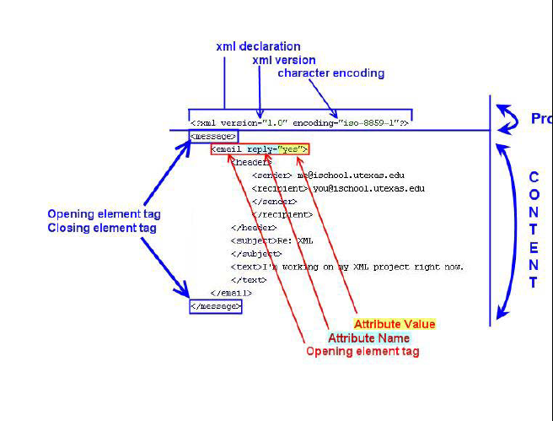
Structure of XML

Slide 10
XML Tree
<?xml version="1.0" encoding="ISO-8859-1"?>
<bookstore> <book category="COOKING"> <title lang="en">Everyday Italian</title> <author>Giada De Laurentiis</author> <year>2005</year> <price>30.00</price> </book>
</bookstore>

Slide 11
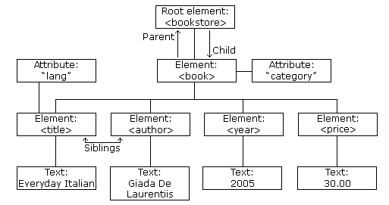
XML Tree

Slide 12
XML Example
<?xml version="1.0" encoding="iso-8859-1"?> <message>
<email>
<header>
<sender>me@ischool.utexas.edu</sender> <recipient>you@ischool.utexas.edu</recipient>
</header> <subject>Re: XML </subject> <text>I'm working on my XML project right now. </text>
</email>
</message>
assign an attribute to the elements <email> indicating whether that document was a reply to a previous message.
<email reply="yes">

Slide 13
XML vs. HTML
XML | HTML
XML is designed to store and carry data | HTML is designed to display data
XML focus on what data is | HTML focus on how data look
Ex: <Student> <ID> 1 </ID> <Name> abc </Name> <City> xyz </City> </Student> | Ex: <i> 1 </i> <b> abc </b> <b> xyz </b>
Extensible set of Tags | Fixed Set of Tags
Allows multiple output forms | Single presentation

Slide 14
Use of XML
Describe contents of document
Exchange data between applications or organizations
Data extracted from database can be preserved with original information and it can be used more than one application or organization in different ways

Slide 15
Advantages
Language independent
A Program written in one language can generate a XML which can be parsed by program written in another language
OS independent
XML document is plain text and has tree structure which is powerful to express complex data and simple to understand
Simplifies Data Sharing

Slide 16
Namespaces
In XML, element names are defined by the developer, which may results into conflict when trying to mix XML documents from different XML applications having same element name
XML data has to be exchanged between organizations
Same tag name may have different meaning in different organizations causing confusion on exchanged documents
Specifying a unique string as an element name avoids confusion
Better solution: use uniquename:elementname
Avoid using long unique names all over document by using XML
Namespaces

Slide 17
Namespaces
HTML table information
<table> <tr> <td> data </td> </tr> <table>
Information about table
<table>
<name> student </name>
<width> 100 </width>
</table>
When two fragments are added with same name, parser will not how to handle this difference
Solving name conflicts using prefix
<t1:table>
<t1:tr>
<t1:td> data </t1:td>
</t1:tr>
<t1:table>

Slide 18
Namespaces
<t2:table>
<t2:name> student </t2:name>
<t2:name> width </t2:name>
</t2:table>
When prefix is used in XML file, namespace for the prefix must be defined
The namespace is defined by the xmlns attribute in the start tag of an element.
Syntax: xmlns:prefix="URI"
Uniform Resource Identifier (URI)
A Uniform Resource Identifier (URI) is a string of characters which identifies an Internet Resource.

Slide 19
Namespaces
<mytable> <t1:table xmlns:t1="http:// www.w3.org/TR/html4 /"> <t1:tr> <t1:td>student</t1:td> <t1:td>width</t1:td> </t1:tr> </t1:table> </mytable>
Another way to specify prefix is as follows:
<root xmlns:t1=http://www.w3.org/TR/html4/> <mytable> <t1:table> <t1:tr> <t1:td>student</t1:td> <t1:td>width</t1:td> </t1:tr> </t1:table>
</mytable>

Slide 20
XML DTD
XML document must be well formed and correct in syntax
Two ways to check whether document follows specific order and structure:
DTD
Schema
DTD - Set of rules defining relationships within a document
The purpose of a DTD is to define the structure of an XML document in terms of elements, tags, attributes, entity.
XML allows to create own DTD for applications, which gives you complete control over the process of checking content and structure of XML documents created for that application.

Slide 21
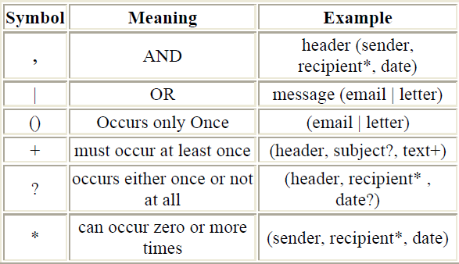
XML DTD (cont…)
When creating a DTD, you need to define all the elements and attributes you'll have in the XML documents.
syntax to remember when creating DTDs are the following:

Slide 22
XML DTD (cont…)
Elements are declared in the following manner:
<!ELEMENT elementName ( elementParts ) >
<!ELEMENT message ( email | letter ) >
Attributes are declared like this:
<!ATTLIST elementName attributeName attributeType attributeDefault >
<!ATTLIST letter reply ( yes | no ) "no" >
DTD can be declared in XML document in two ways:
Internal
External

Slide 23
XML DTD (cont…)
Internal DTD
<!DOCTYPE rootElement [
Element and attribute declarations go here between the brackets ]>
<?xml version=“1.0” ?>
<!DOCTYPE mail [
<!Element mail (to, from, title, message)>
]>
External DTD
<!DOCTYPE RootElementName SYSTEM "DTDfileLocation">
SYSTEM in the DTD declaration can be replaced by PUBLIC if the DTD is available via the Internet.
<!DOCTYPE message SYSTEM "message.dtd">

Slide 24
XML DTD (cont…)
PCDATA - Parsed Character Data
Parsed Character Data (PCDATA) is a term used about text data that will be parsed by the XML parser.
CDATA - (Unparsed) Character Data
Everything inside a CDATA section is ignored by the parse
Characters like "<" and "&" are illegal in XML elements. To avoid errors code can be defined as CDATA
A CDATA section starts with "<![CDATA[" and ends with "]]>".
A CDATA section cannot contain the string "]]>".
Nested CDATA sections are not allowed.

Slide 25
XML DTD (cont…)
The "]]>" that marks the end of the CDATA section cannot contain spaces or line breaks.
External DTD
<?xml version=“1.0”?>
<!DOCTYPE mail SYSTEM “mail.dtd”>
<mail>
<to> abc </to>
<from> xyz </from>
<title> mail title </title>
<message> simple message </message>
</mail>

Slide 26
XML DTD (cont…) - Example
When creating a DTD for our message XML files, we would have something like this:
<!ELEMENT message ( email | letter ) >
<!ELEMENT letter ( letterhead, text ) >
<!ELEMENT email (header, subject?, text+) >
<!ATTLIST letter reply ( yes | no ) "no" >
<!ATTLIST email reply ( yes | no ) "no" >
<!ELEMENT header ( sender, recipient*, date?) >
<!ELEMENT subject ( #PCDATA) >
<!ELEMENT letterhead ( sender, recipient*, date ) > <!ELEMENT sender ( #PCDATA ) >
<!ELEMENT recipient ( #PCDATA ) >
<!ELEMENT date ( #PCDATA ) >
<!ELEMENT text ( #PCDATA | salutation )* >
<!ELEMENT salutation ( #PCDATA ) >

Slide 27
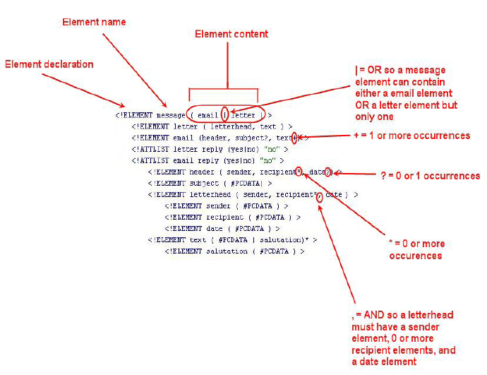
XML DTD (cont…) - Example

Slide 28
XML Schema
XML schema is a description of the structure and rules of a document must satisfy for an XML document type.
It also includes the formal declaration of the elements that make up a document.
If XML file does not obey the syntax of its associated DTD or Schema, it is not valid.
XML Schema is a more sophisticated schema language which
addresses the drawbacks of DTDs.
XML Schema Supports
Type of values (integer, string, etc )
Userdefined, comlex types
Many more features, including uniqueness and foreign key constraints, inheritance

Slide 29
XML Schema
XML Schema is itself specified in XML syntax
XML Scheme is integrated with namespaces
XML Schema is significantly more complicated than DTDs.
Schema Element
<name>
<firstname> abc </firstname>
<lastname> abc </lastname>
</name>
<xs:element name=“firstname” type=? />
<xs:element name=“lastname” type=? />

Slide 30
XML Schema
Element Type
xs:string
xs:decimal
xs:integer
xs:boolean
xs:date
xs:time
<xs:element name=“firstname” type=“xs:string” />
<xs:element name=“lastname” type=“xs:string” />
Schema Attribute
<firstname lang=“english”> abc </firstname>
Schema Definition
<xs:attribute firstname=“lang” type=“xs:string” />

Slide 31
XML Schema
‘fixed’ attribute in schema
<xs:attribute firstname=“lang” type=“xs:string” fixed=“English” />
‘default’ attribute in schema
<xs:attribute firstname=“lang” type=“xs:string” default=“English” />
Schema attribute can be optional or required
<xs:attribute firstname=“lang” type=“xs:string” use=“optional” />
<xs:attribute firstname=“lang” type=“xs:string” use=“required” />

Slide 32
XML Validation
XML with correct syntax is "Well Formed" XML.
XML validated against a DTD is "Valid" XML.
Well Formed XML Documents
A "Well Formed" XML document has correct XML syntax.
XML documents must have a root element
XML elements must have a closing tag
XML tags are case sensitive
XML elements must be properly nested
XML attribute values must be quoted

Slide 33
XML Validation
XML validator is used to syntax-check your XML.
Syntax-Check Your XML
<?xml version="1.0" ?>
<note>
<to>Tove</to>
<from>Jani</Ffrom>
<heading>Reminder</heading>
<body>Don't forget me this weekend!</body>
</note>

Slide 34
XML
Viewing XML Files
<?xml version="1.0" encoding="ISO-8859-1"?>
- <note>
<to>Tove</to>
<from>Jani</from>
<heading>Reminder</heading>
<body>Don't forget me this weekend!</body>
</note>
The XML document will be displayed with color-coded root and child elements. A plus (+) or minus sign (-) to the left of the elements can be clicked to expand or collapse the element structure.

Slide 35
XMLHttpRequest Object
The XMLHttpRequest object is used to exchange data with a server behind the scenes.
Update a web page without reloading the page
Request data from a server after the page has loaded
Receive data from a server after the page has loaded
Send data to a server in the background
Create an XMLHttpRequest Object
xmlhttp=new XMLHttpRequest();
Old versions of Internet Explorer (IE5 and IE6) uses an ActiveX Object:
xmlhttp=new ActiveXObject("Microsoft.XMLHTTP");

Slide 36
XML Parser
An XML parser converts an XML document into an XML DOM object - which can then be manipulated with JavaScript.
if (window.XMLHttpRequest) {// code for IE7+, Firefox, Chrome, Opera, Safari xmlhttp=new XMLHttpRequest(); } else {// code for IE6, IE5 xmlhttp=new ActiveXObject("Microsoft.XMLHTTP"); }
xmlhttp.open("GET","books.xml”,false); xmlhttp.send(); xmlDoc=xmlhttp.responseXML;
Note : XMLHttpRequest object to behave as AJAX, the async parameter of the open() method has to be set to true:

Slide 37
XSL
XSL = XML Transformation
The eXtensible Style Language
Transforms XML into HTML
Actually, transforms XML into a tree, then turns that tree into another tree, then outputs that tree as XML
XSL
Stylesheet
XML
Source
XSL
Processor
HTML
Output

Slide 38
XSL
XSL is a series of rules or templates
Each template matches an element
Templates can contain XML commands
XSL Commands: apply-templates
Main rule: apply-templates
looks for a template match
applies it
Usually the template calls apply-templates recursively on its children
If not, then processing stops at that node (but continues for its other siblings that matched this template)

Slide 39
XSL
For a leaf node, output its contents
For a branch node, apply templates (recursively) (including default rule)
Some XSL Commands
value-of
grabs raw value, good for text elements and attributes
if
executes conditionally
number
counts position of element in group
good for ordered list numbering, table of contents, etc.

Slide 40
XSL conditionals: if
<xsl:if test="author"> by <xsl:apply-templates select="author" /> </xsl:if>
Note: no else (?!?)

Slide 41
XSL Conditonals: choose
<xsl:choose> <xsl:when test="url"> <A href="{url}">
<xsl:choose> <xsl:when test="name"> <xsl:value-of select="name" /> </xsl:when>
<xsl:otherwise> <xsl:value-of select="url" /> </xsl:otherwise> </xsl:choose>
</A> </xsl:when>
<xsl:otherwise> <xsl:value-of select="name" /> </xsl:otherwise>
</xsl:choose>

Slide 42
XSL Looping: for-each
<xsl:for-each select="chapter"> <h2><xsl:value-of select="@title"/> </h2> </xsl:for-each>

